Slide 1
Requirements Engineering: SMART
Software Engineering
Neil Toporski

Slide 2
1 Requirements [Outline]
What is a Requirement? User and System Requirements
Functional and Non-Functional Requirements
SMART Requirements

Slide 3
1.1 What is a Requirement?
At its simplest, a requirement is a service, function or feature that a user needs. Requirements can be functions, constraints, business rules or other elements that must be present to meet the need of the intended users.
Usually expressed as a User Story.
Acceptance criteria’s primary purpose is to state how we can accept the requirement.
Testable: non-ambiguous, measurable
Does not include how the requirement will be implemented (programmed)
Notes:
I want to do something for some reason
Acceptance Criteria = tasks
Starting on Trello today
Filling up the board with user stories
Come up with a list of tasks that can be programmed
Because they’re programmed, need to be testable ^ (how do I know it’s done)
Move it into the Sprint backlog

Slide 4
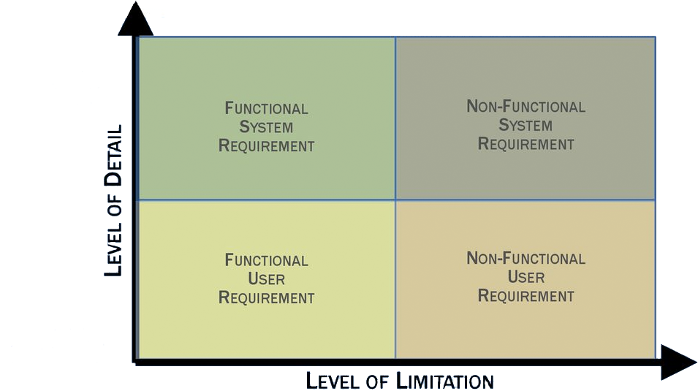
Classification of Requirements Uses a Two-Dimensional Matrix
System
Requirement
System
Requirement
Level of Detail
User
Requirement
User
Requirement
Level of Limitation
Level of Limitation
Non-Functional
Requirement
Functional
Requirement
Non-Functional
Requirement
Functional
Requirement

Slide 5
1.2 User vs System Requirements
User Requirements
User requirements are statements, in natural language of what the system is expected to do or provide. User requirements stem from the client.
System Requirements
System requirements describe the software system’s function, services, and constraints. System requirements should define exactly what is to be implemented and how. System requirements stem from product design.
Notes:
User requirements → what does the user wants?
System requirements → function, how is it going to be built?
- Come from user requirements

Slide 6
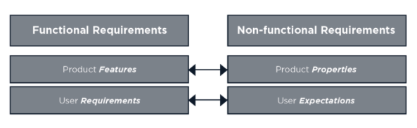
1.3 Functional and Non-Functional Requirements
Software requirements are often classified as
Functional or
Non-Functional
WHAT the System Should Do
HOW the System Should Do it

Slide 7
Functional or Non-Functional?
Functional Criteria: Identifies specific user tasks, functions or business processes that must be in place. A functional criterion might be “A user is able to access a list of available reports.” (What the system should do)
Non-functional Criteria: Identifies constraints: specific conditions the implementation must meet, such as design elements. A non-functional criterion might be “Edit buttons and Workflow buttons comply with the Site Button Design.” (How the system should do it)
Notes:
Ex. Want a user to add in text for case-based scenario in a textbox
Textbox is a functional requirement
The type/size/location of font display is non-functional
Span for a lot of different reasons and areas

Slide 8
Functional or Non-Functional?
Nonfunctional Requirements (NFRs) constrain functional requirements. In other words, the capabilities designed and developed to address functional requirements must also support or contribute to meeting NFRs at the system level.
Nonfunctional Requirements define system attributes such as security, reliability, performance, maintainability, scalability, and usability.

Slide 9
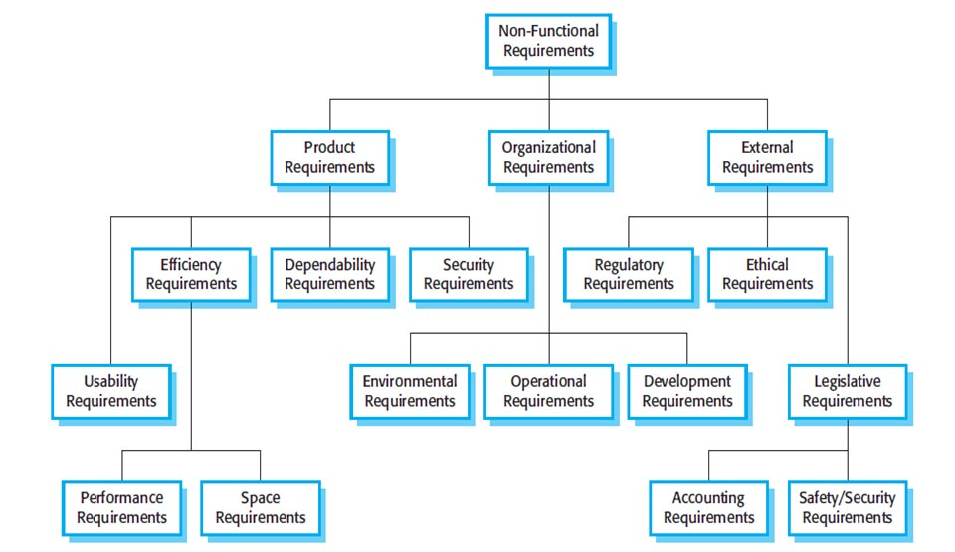
Non-Functional Requirement Types
Notes:
Security → encryption? Protected data?
Performance → done in a certain amount of time
Ethical → might stem from legislative requirements
These are all constraints (what’s necessary to build it)

Slide 10
Functional and Non-Functional Requirement Examples
Functional requirement (WHAT) | Non Functional Requirement (HOW)
When an order is fulfilled, the local printer shall print a packing slip. | Packing slips shall be printed on both sides of 4”x 6” white paper, the standard size for packing slips used by local printers.
The software system should be integrated with banking API. | The software should be portable. So moving from one OS to other OS does not create any problem.
An operating system requires that users enter a password and username when logging in so that the system can authenticate their identity. | An operating system shuts down automatically when detecting a potential security threat.

Slide 11
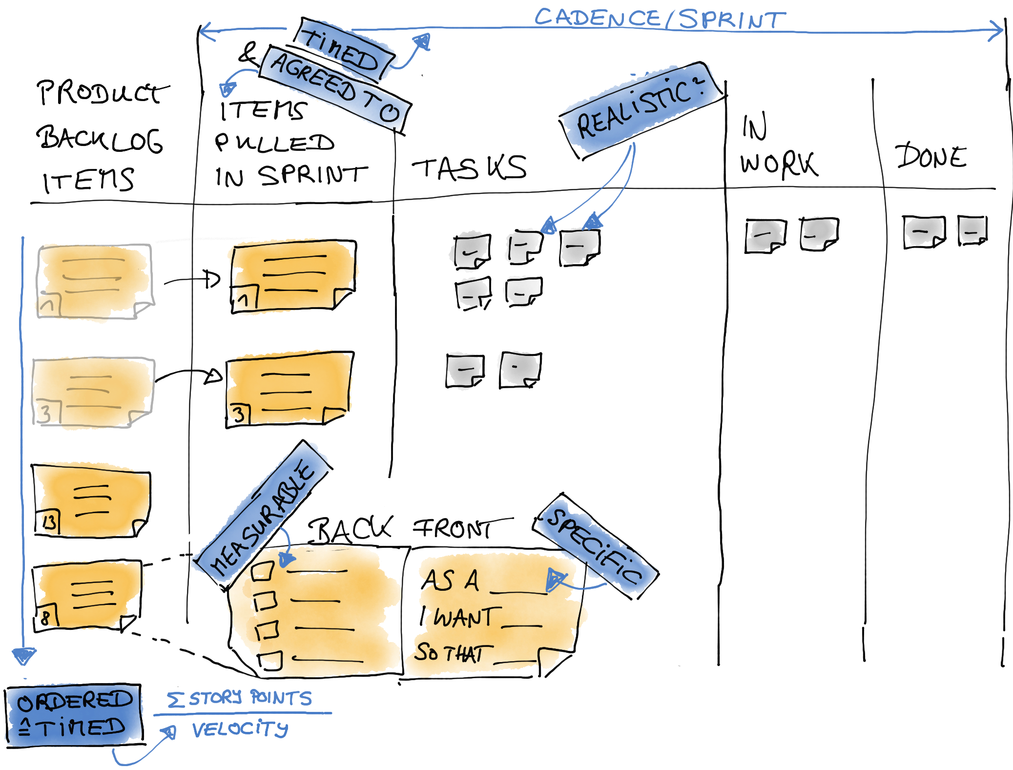
1.4 SMART Requirements
Writing requirements and specifications can be challenging. To help focus and ensure that the correct type information is captured, The “SMART” system helps write better requirements.
Specific
Measurable
Atomic (sometimes Attainable)
Realistic (sometimes Relevant)
Traceable

Slide 12
SMART Requirements: Specific
Is the requirement both concise and complete?
In order to create goals that are clear and understandable, we use the user story technique in Scrum. A brief reminder: the term “user story” refers to sentences formulated in the form: “As a <beneficiary> I want <goal> so that <benefit>.” Goals in Scrum are the entries in the Product Backlog. User stories are useful because we do not only address the goal itself, but also its benefits and beneficiaries. This helps us to be more precise – alas specific.
So: “Specific” is addressed by the user story technique.
Notes:
User story
Breaking it down into some sort of user
Wanting to use this for some reason
Being very specific
Taking it and moving it into the task itself

Slide 13
SMART Requirements: Measurable
Can this requirement be interpreted only one way, regardless of the reader’s perspective?
The ‘measurable’ part of a goal are the acceptance criteria in Scrum. Acceptance criteria helps us define Definition of “Done”.
So: “measurable” is addressed by acceptance criteria and the Definition of “Done”.
Property | Measure
Performance | Processed transactions/second User/event response time Screen refresh time
Space | Mbytes Number of ROM chips
Usability | Training time Number of help frames
Reliability | Mean time to failure Probability of unavailability Rate of failure occurrence Availability
Robustness | Time to restart after failure Percent of events causing failure Probability of data corruption on failure

Slide 14
SMART Requirements: Atomic
Does the requirement describe only one piece of functionality?
If a requirement sounds like there are two or more different functions described, split it up!
Notes:
Are they as granular as you can take them?

Slide 15
SMART Requirements: Realistic
Is this requirement possible to achieve, given what is known about the systems, resources, budget, and due date?
When pulling Product Backlog entries into the Sprint, the team checks whether the Product Backlog entry is realistically reachable in the Sprint timebox. The team also checks this by splitting an entry into tasks. Less obvious is the check of “realistic” in the Product Backlog Refinement. The joint discussion avoids that unattainable goals are included in the Product Backlog in the first place. By constantly inspecting and adapting, the point “realistic” is constantly re-examined in relation to what has been achieved so far.
So: “Realistic” is addressed by pulling Product Backlog items into the Sprint and splitting them into tasks
Notes:
Is it doable?
Reevaluate as a team as creating the first sprint

Slide 16
SMART Requirements: Traceable
Can the requirement be traced back to the client goals or business problem?
Is it clear how the final solution can be tested to prove that this requirement is met?
Notes:
What’s the business goal?
Keeping the goal in mind?
Are the user requirements still being met as you’re building this?

